Slide 1
DIGITAL IC DESIGN · CAPSTONE 2025
RISC-V SoC with
Network-on-Chip-Inspired
Multi-Core Interconnect
RV32I
C0
RV32I
C1
NoC FABRIC
DUAL-CORE RV32I SoC
Digital IC Design & Verification Capstone Project
Kashish Shaikh · Lareb Saba · Muskan Jarwar

Slide 2
01
Project Objective
01
02
03
04
2× RV32I cores
Private IMEM
Shared 8 KB SRAM
4 routed targets
05
06
07
08
Round-robin fairness
Inter-core mailbox
UART + GPIO
UVM + Sky130A + FPGA

Slide 3
02
System Architecture
RV32I CORE 0
8 KB
SRAM
MAILBOX
4 REG
ADDR DECODE
+
4× ARBITER
+
REQ/RSP MUX
4 KB IMEM0
RV32I CORE 1
UART
TX
GPIO
8 LED
4 KB IMEM1
Different slaves proceed in parallel · same slave uses fair round-robin arbitration

Slide 4
03
NoC-Inspired Interconnect
2 DECODERS
4 PER-SLAVE ARBITERS
RESPONSE MUX
ARB 0 · ROUND ROBIN
DECODER M0
ARB 1 · ROUND ROBIN
RSP MUX
→ M0 / M1
DECODER M1
ARB 2 · ROUND ROBIN
ARB 3 · ROUND ROBIN
CONTROL FSM
IDLE
DECODE
ARBITRATE
TRANSFER
RESPONSE

Slide 5
04
System Address Map
TARGET BASE ADDRESS SIZE NOTES
PRIVATE
0x0000_0000
4 KB ×2
IMEM0 / IMEM1
SRAM
0x1000_0000
8 KB
byte · half · word
MAILBOX
0x2000_0000
256 B
2 data + 2 flags
UART
0x3000_0000
256 B
TXDATA 00 · STATUS 04
GPIO
0x3000_0100
256 B
GPIO_LED · 8 outputs
UNMAPPED
—
—
HRESP_ERROR · 0 wait

Slide 6
05
RTL Design & Hierarchy
soc_top
rv32i_core ×2
imem ×2
noc_interconnect
decoder · regfile · ALU
private instruction ROM
2 decoders · 4 arbiters · mux
shared_dmem
ic_mailbox
uart + gpio
8 KB · byte/half/word
2 data · 2 flag registers
TX FSM · LED register
Synthesizable Verilog · IEEE 1364-2005 · shared rv32i_soc_defines.v

Slide 7
06
AHB-Lite-Inspired Bus Protocol
haddr[31:0]
byte address
hwrite
1 write · 0 read
hsize[1:0]
byte · half · word
hwdata[31:0]
write payload
hvalid
held until hready
hrdata[31:0]
read response
hready
complete this cycle
hresp
OKAY / ERROR
REQUEST
DECODE / ARBITRATE
TRANSFER
HREADY / RESPONSE
hvalid and request fields remain stable throughout wait cycles

Slide 8
07
Verification Strategy
RTL
DIRECTED TB
UVM ENV
SCOREBOARD
COVERAGE
SVA
✓ Reset
✓ Arbitration
✓ Mailbox
✓ UART TX
✓ GPIO / LED
✓ Unmapped
✓ Back-to-back
✓ Parallel routing
Directed masters bypass cores for precise timing · UVM mirrors scenarios and round-robin flips

Slide 9
08
UVM-1.1 Architecture
ahb_base_test · 9 sequences
UVM_ACTIVE MASTER AGENT 0
UVM_ACTIVE MASTER AGENT 1
SEQUENCER
DRIVER
MONITOR
SEQUENCER
DRIVER
MONITOR
ahb_scoreboard
ahb_coverage
transaction: addr · write · wdata · size · rdata · resp · wait_cycles · master_id

Slide 10
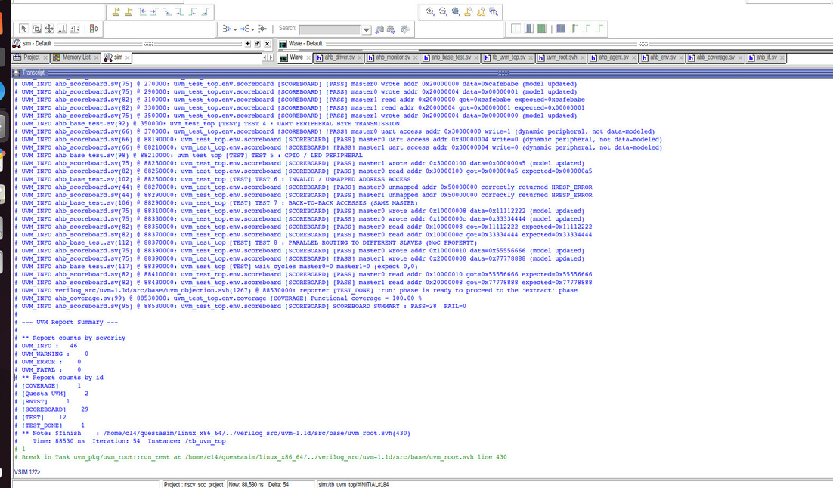
09
UVM Results
28/28
100.00%
0
0 / 0
SCOREBOARD CHECKS
FUNCTIONAL COVERAGE
SVA VIOLATIONS
UVM ERROR / FATAL
PASS
3 CROSS-COVERAGES
4 PROPERTIES
CLEAN REPORT
reset-clears-valid · no-unknown-address · stable-during-wait · no-indefinite-hang
VERIFICATION SIGN-OFF: CLEAN

Slide 11
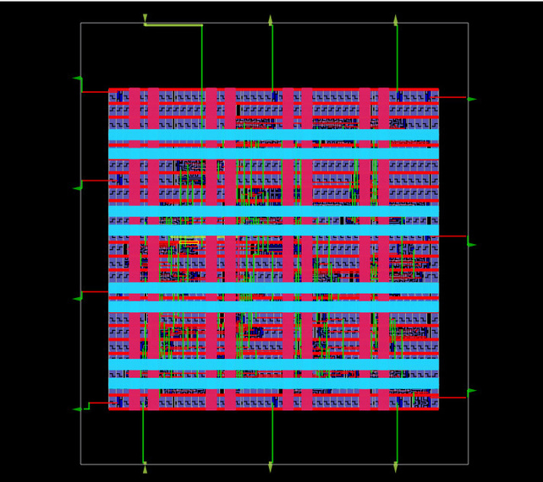
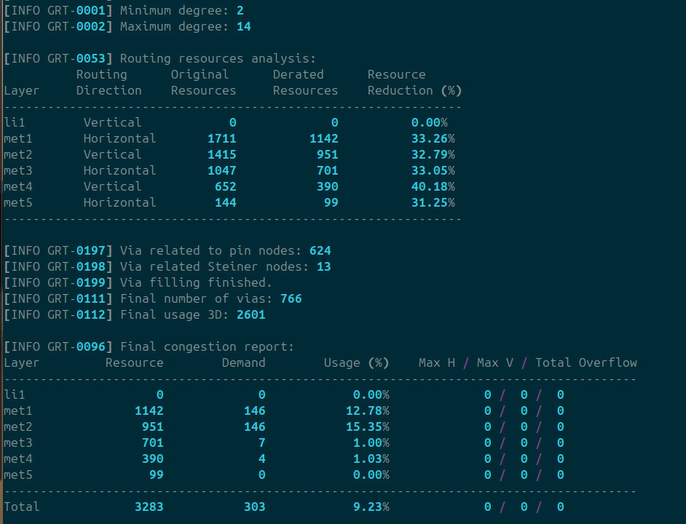
10
ASIC Physical Design Flow
OpenLane / LibreLane · SkyWater sky130A · sky130_fd_sc_hd
RTL
SYNTH
FLOORPLAN
PDN
PLACE
CTS
ROUTE
RCX
SIGN-OFF
GDSII

Slide 12
11
ASIC Sign-Off Results
50 MHz
6550.1 µm²
35.7%
13.73 ns
20.0 ns target
75.75 × 86.47 µm die
core utilisation
worst setup slack · MET
0.107 ns
0 / 0
892
≈0.114 mW
worst hold slack · MET
DRC / antenna
total instances
post-route power
Timing MET · Routing CLEAN · GDSII generated

Slide 13
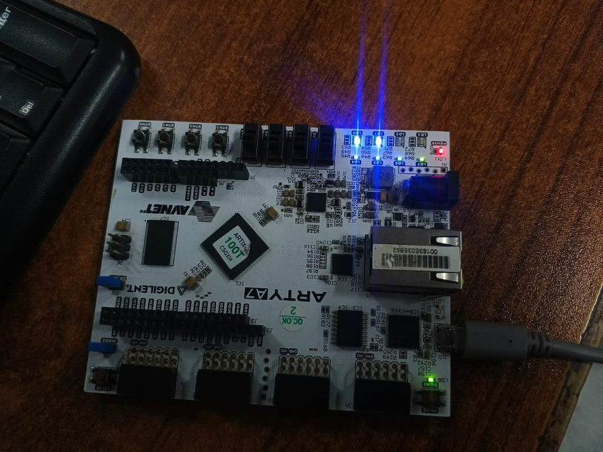
12
FPGA Implementation & Live Demo
VERILOG RTL
YOSYS
VPR
FASM
BITSTREAM
CLK100MHZ · E3 — 100 MHz
btn_reset · D9 — active high
uart_tx · A9 — USB-UART
led[3:0] — GPIO
Arty A7-100T · xc7a100t
Dual programs · shared memory · mailbox · UART · LEDs
led[4] / led[5] — mailbox flags

Slide 14
13
Final Results & Conclusion
RTL
INTERCONNECT
COMMUNICATION
Dual-core RV32I SoC complete
Routing + round-robin arbitration
Shared SRAM + mailbox
PERIPHERALS
VERIFICATION
IMPLEMENTATION
UART + GPIO functional
28/28 · 100% · 0 SVA
Sky130A GDSII + Arty A7 demo
THANK YOU

